Slide 1
Thesis on
TEXT SUMMARIZATION FOR WEATHER FORECASTING USING MACHINE LEARNING
Student name
Course
Professor
Institution
Date

Slide 2
Abstract
This study thoroughly examines the effectiveness of sophisticated neural architectures and classic machine learning classifiers in summarizing meteorological data.
The main objective is to assess and contrast models like the Transformer and Long Short-Term Memory (LSTM) in their ability to capture complex patterns in high-frequency meteorological data.
In addition, the paper investigates the suitability of conventional classifiers, such as Logistic Regression, Random Forest, and Support Vector Machines (SVM), for analyzing weather datasets organized in a tabular format.
We needed to obtain a wide range of detailed datasets to understand better and summarize meteorological data for our research.
The acclaimed WorldWeatherOnline.com, a famous website, served as our key source for obtaining extensive and precise atmospheric information.
The research technique entails a rigorous assessment process, employing a varied weather dataset with 24 parameters observed over 1464 hours..
.
Notes:
The prediction accuracy of the Transformer and LSTM models is evaluated by assessing their performance on various weather features using metrics such as Mean Squared Error (MSE), Root Mean Squared Error (RMSE), and cosine similarity values. Noteworthy findings are uncovered with the application of sophisticated neural architectures. The Transformer model accurately forecasts cosine similarity values, particularly excelling in temperature-related parameters. Nevertheless, although the LSTM model performs well, it encounters difficulties in minimizing Mean Squared Error (MSE) and Root Mean Squared Error (RMSE), mainly when dealing with precipitation, pressure, and temperature indices

Slide 3
CHAPTER 1 1.0 Background of the study
Weather forecasts significantly impact our daily decisions, activities, and security. Accurate predictions are crucial for deciding the optimal time to embark on a vacation, selecting appropriate items to bring along, or effectively planning for a weather-related crisis [23].
The ability to provide precise weather forecasts relies on the diverse array of devices, satellites, and sensors that scientists employ [21]. All factors considered include the temperature, humidity, kinetic energy, and air pressure.
The findings of Mostajabi et al. [18] can assist in predicting many weather phenomena, such as precipitation, temperature patterns, storm systems, and others.
Weather forecasts occasionally utilize scientific terminology and specialized lexicon. According to Hartnett's [15] research, listeners who are not meteorologists may find terms such as "low-pressure system," "frontal boundary," and "isobar" unfamiliar.
A sufficient understanding of weather forecasts can result in suboptimal decision-making, such as disregarding necessary precautions during severe weather occurrences or neglecting to consider weather-related hazards while planning a trip [13].
Notes:
Ye et al. [24] suggest that delivering precise, prompt information can effectively decrease human casualties and property destruction. The problem of accessing this information is particularly urgent for economically disadvantaged individuals, as they may need more resources and knowledge to comprehend intricate weather forecasts. The dissemination of easily understandable and transparent weather information is essential for promoting inclusivity and safeguarding the population's well-being. Despite significant advancements in weather forecasting, there exists a gap between the extensive amount of advanced meteorological data accessible to meteorologists and the public's ability to comprehend and efficiently apply this information. This project addresses this gap by developing a text summarization tool to streamline complex weather forecasts. The primary objective is to enhance public safety, enhance accessibility, and augment understanding of weather patterns.

Slide 4
1.2 Aims and Objectives
This project endeavors to create a robust text summarization technology capable of transforming intricate meteorological data into comprehensible summaries to assist individuals in making informed decisions based on weather forecasts.
Objectives:
Data collection and preparation: The project will gather and process historical and current meteorological data for training and testing machine learning models.
Model development and refinement: The project will create and optimize machine learning models that can generate summaries of weather-related information from complex datasets.
Interface design and testing: The project will design and test a user-friendly interface that can facilitate the submission and retrieval of weather summaries.
Model deployment and evaluation: The project will make the summary generator available on various web and mobile platforms and collect feedback from users to improve its usefulness and accessibility.

Slide 5
1.3Problem Statement
The complexity of weather prediction and the difficulties it poses for the general public are the central focus of this endeavor.
The weather forecasts for today may be challenging to understand because of the use of technical terminology, extensive information, and abstract scientific ideas [14].
This intricacy's core is the potential for inaccurate interpretations of crucial meteorological information. Individuals may exhibit poor decision-making with unforeseen consequences when they need help comprehending intricate weather forecasts.
Insufficient comprehension of the associated hazards might leave individuals ill-equipped to face severe weather events such as thunderstorms, floods, and heat waves.
Inadequate decision-making can result in significant repercussions for enterprises and industries that depend on weather-dependent activities, such as agriculture, transportation, and tourism.
Our project aims to create a text summarization tool to tackle this intricate problem. Our study is driven by the lack of accessibility to weather forecasts and their potential impact on public decision-making and results.

Slide 6
1.4 State of Art
To contextualize our work within the existing body of knowledge, we explore the intricate field of meteorological data summarization, utilizing sophisticated methodologies in machine learning and deep learning.
The thorough cleaning and transforming of data, which includes separating and standardizing numerical and textual data, prepares for targeted model training.
We utilize advanced methods like MinMax scaling and embedding algorithms to handle the complexities of weather data, capturing both immediate fluctuations and temporal patterns.
The core of our study focuses on constructing a summarization model that utilizes a sophisticated neural architecture combining the advantageous features of Long Short-Term Memory (LSTM) and Transformer models.
The reason for using this dual-model method is based on each model's unique qualities for the summarization task.
The LSTM model, known for its ability to capture short-term fluctuations and sequential relationships, enhances the parallel processing and attention mechanisms of the Transformer model.
Notes:
The ensuing synergy comprehensively comprehends the intricate, frequent weather dataset. The meticulous choice of these architectures is based on the latest trends, recognizing the significance of considering both temporal complexities and global context awareness in summarizing weather data. The study design includes the factors and levels examined in the experiment, the algorithm settings, and the performance evaluation criteria. This technique demonstrates a rigorous adherence to current standards in machine learning experimentation.

Slide 7
1.5 Motivation
The rationale for this study is based on the urgent requirement for progress in methodologies for summarizing meteorological data, prompted by the growing quantity and intricacy of atmospheric data.
Conventional approaches frequently face difficulties in extracting significant insights from the extensive and varied datasets that are accessible, mainly when dealing with frequent weather observations.
The increasing use of machine learning and deep learning techniques in several fields has showcased their capacity to handle intricate data structures, leading to investigation of their suitability for summarizing meteorological data.
The studies conducted by Sowdaboina et al. [2] and Mahalakshmi and Fatima [3] emphasize the importance of utilizing machine learning and deep learning methods to improve summarization processes, which is the basis for our investigation.
Furthermore, the project is motivated by the practical consequences of a precise summary of meteorological data in several areas, including agriculture, renewable energy, and emergency management.
The studies undertaken by Singh et al. [6], Salman et al. [7], and Sharma et al. [9] highlight the crucial importance of accurate weather forecasts in agriculture and renewable energy systems.
Notes:
The need to create strong summarization models arises from their potential influence on decision-making processes in these domains. In addition, the studies conducted by Scher and Messori [10] and Haupt et al. [11] emphasize the broader range of uses for machine learning in weather forecasting. These include its contribution to tackling renewable energy, transportation, and wildfire prediction issues. The references we have provided highlight the study's practical importance and significance, underlining the requirement for creative methods to summarize weather data in response to current difficulties.

Slide 8
CHAPTER 2: RELATED WORK
The discipline of meteorology plays a crucial role in our daily lives, impacting several industries, including agriculture and transportation, and influencing decision-making in other areas [1].
The growing significance of precise and rapid weather forecasts has stimulated research endeavors to employ contemporary approaches such as machine learning, deep learning, and natural language processing to enhance the precision and accessibility of weather predictions.
This literature review thoroughly analyzes many studies that examine innovative approaches to weather forecasting, text summarization, and image captioning.
The analysis seeks to offer insights into the possible uses of these approaches in tackling the ever-changing challenges encountered in meteorology and information retrieval.
In today's era of abundant data, there is an increasing focus on the procedures for compressing and extracting practical insights from large datasets.
Furthermore, acknowledged importance is placed on enhancing the clarity and accessibility of information by using image captions. These two factors have become crucial areas of focus.
Notes:
Moreover, the impact of weather forecasts extends to other sectors, underscoring the importance of utilizing machine learning and deep learning techniques to improve the accuracy and efficiency of predictions. This paper comprehensively analyzes the previously described research and its potential consequences for weather forecasting. It emphasizes the importance of using context-specific approaches and high-quality data to maximize efficiency. The study's main objective was to determine the optimal level of abstraction for summarizing time-series data. The weather forecasting business can benefit from utilizing the provided corpus for training and assessing machine learning models. The study's findings offer a reliable and relevant basis for addressing content selection when summarizing time series data [2].

Slide 9
In the abundance of information available today, Mahalakshmi and Fatima [3] highlighted the importance of integrating deep learning methods into information retrieval systems for text summarization and image captioning.
Scientists have created an innovative algorithm that can condense written information and generate descriptive captions for images, thereby enhancing the accessibility of visual content.
Deep learning approaches substantially improved precision, recall, and F-score during testing [3].
Mekuria and Jagtap [4] introduced a customized approach for summarizing Amharic material that used extractive and abstractive techniques.
To address the unique challenges of translating Amharic literature, the researchers employed the PageRank algorithm to evaluate the significance and relevance of phrases.
This study contributes significantly by focusing on linguistic summarization in languages other than English, particularly the Amharic language and its textual content

Slide 10
In their study, Dhanya et al. [5] aimed to examine and evaluate state-of-the-art techniques for automated text summarizing.
Strategies that retrieved data and strategies that summarized it were among those employed.
This study examined the application of summarization techniques in various scientific and business situations.
This survey can provide valuable insights for both researchers and practitioners in the field of information retrieval.
Doing this has provided a comprehensive evaluation of the latest developments in text summarization [5].
Singh et al. [6] employed the random forest classification technique to develop a more accurate weather prediction system in their weather forecasting research.
The study's primary focus on agriculture highlighted the critical importance of precise weather forecasts.
Notes:
Random forests, a machine learning technique, have demonstrated potential in swiftly analyzing intricate data sets to produce dependable predictions. Nevertheless, the study recognized the crucial significance of the accuracy of input meteorological data and the possible geographical coverage limitations that could hinder the system's performance [6]. The importance of emphasizing data quality and acknowledging regional variability must be considered when building efficient weather forecasting systems.

Slide 11
In their study, Salman et al. [7] investigated the possible use of deep learning methods, such as Recurrent Neural Networks (RNN) and Convolutional Networks (CN), for weather forecasting.
Their study aimed to evaluate the capacity of deep learning to capture temporal and spatial trends in meteorological data.
The study investigated the importance of precise weather forecasting in various sectors and acknowledged that the effectiveness of deep learning models can vary depending on factors such as the dataset and the particular geographical region being analyzed [7].
Holmstrom et al. [8] undertook a study that applied machine learning techniques in weather forecasting, explicitly aiming to enhance temperature predictions over seven days.
The study emphasized the advantages of employing machine learning models over conventional methods for making extended predictions, specifically in temperature forecasting.
Notes:
To summarize, the works above collectively contribute to the progress of understanding the possibilities and challenges involved in enhancing weather forecasting. This is accomplished by employing several approaches, such as machine learning, deep learning, and advanced statistical models. The user's statement highlights the need for precise and dependable data, the contextual uniqueness of predictive models, and the extensive usefulness of these technologies in various industries. Furthermore, these findings support the need for further research into minimizing limitations and inequalities in machine learning and deep learning approaches to improve the accuracy and accessibility of weather predictions in many scenarios and fields.

Slide 12
2.2 Research Gap
The comprehensive literature evaluation identifies various research deficiencies in the present state of weather forecasting methodology and the utilization of machine learning and deep learning techniques.
More research needs to focus explicitly on the difficulty of including several languages and linguistic differences, apart from English, in summarizing weather predictions, despite the growing interest in using machine learning for this purpose.
The study by Mekuria and Jagtap [4] is praiseworthy as it focuses on Amharic text summary.
However, there needs to be more such research for other languages.
Bridging this gap to provide a universally applicable and linguistically diverse framework for summarizing weather data is essential.
Furthermore, although multiple studies, including the research conducted by Holmstrom et al. [8], highlight the benefits of machine learning models in weather forecasting, there needs to be more agreement regarding the most efficient modeling methods for different forecast durations.
The scientific community still needs to fully grasp how machine learning models' performance varies with the duration of weather predictions.
Notes:
The available research offers many methods for summarizing meteorological data, including content selection techniques [2] and the integration of deep learning for text summarization and image captioning [3]. Nevertheless, it is imperative to do research that methodically compares and assesses these various approaches, considering characteristics such as efficiency, accuracy, and adaptability. This research gap emphasizes the need for a thorough comprehension of the advantages and drawbacks of various summary techniques, which will facilitate the creation of unified and optimized frameworks for summarizing weather data. To summarize, overcoming these research gaps will significantly contribute to the progress of weather forecasting systems, guaranteeing their effectiveness across different languages, various forecast timeframes, and unique contextual situations

Slide 13
CHAPTER 3: METHODOLOGY
3.1.1: Data Source
We needed to obtain a wide range of detailed datasets to understand better and summarize meteorological data for our research.
The acclaimed WorldWeatherOnline.com, a renowned platform for offering extensive and accurate weather data [30], was our primary source for this abundant atmospheric information.
3.1.2: Data Cleaning and Transformation
The transformation from unprocessed meteorological data to a polished dataset suitable for modeling required a rigorous procedure of data preparation, partitioning, normalization, and label creation.
This section reveals the complexities of these preliminary processes, emphasizing the choices and approaches that established the foundation for our subsequent efforts in training the model.
To address this issue, we implemented a segregation procedure that separated number columns from their corresponding textual columns.
The division mentioned established the basis for targeted preprocessing, allowing for separate numerical and textual data treatment due to their unique characteristics [31].
Notes:
Consistency in magnitude is crucial when working with numerical data, particularly in neural network embeddings. Utilizing the MinMax scaling technique, we standardized the numerical data, ensuring that all columns were uniformly scaled [32]. This promoted convergence during the training process and guaranteed that each feature contributed equally to the model's comprehension, preventing any particular parameter from dominating. We implemented an embedding method to capture the temporal patterns present in the meteorological data.

Slide 14
3.2: Summarization Model Development
The neural architecture proposed for meteorological data summarization utilizes two separate models, Long Short-Term Memory (LSTM) and Transformer, which function separately [34].
The purpose of this technique is to use each model's distinct advantages and then evaluate their performances in extracting significant insights from the high-frequency weather dataset, which includes 24 different metrics recorded over 1464 hours.
The LSTM model is responsible for catching transient fluctuations in the weather data.
The LSTM model analyzes the daily embeddings formed by combining 64 consecutive hourly values. This allows for a complete description of the short-term fluctuations in the meteorological conditions.
Conversely, the Transformer model, famous for its attention processes, captures distant connections and contextual associations within sequences.
The attention methods allow the model to evaluate the significance of various timestamps and parameters, improving its capacity to identify patterns over prolonged durations.
Notes:
The output from both the LSTM and Transformer models is subsequently fed into a Multilayer Perceptron (MLP) with 24 output neurons, each utilizing a hyperbolic tangent (tanh) activation function [36]. The goal is to establish a cohesive framework for the following phases of the model. The last stage utilizes a Mean Squared Error (MSE) loss function to optimize the model's parameters by minimizing the disparity between the anticipated and actual cosine similarity values. The cosine similarity is calculated by evaluating the similarity between the embeddings of each parameter, which offers a quantitative indication of their closeness to meteorological conditions. The TextRank algorithm assigns the output neuron corresponding to each day with the highest cosine similarity. The algorithm, modified to summarize weather data, assesses the importance of each characteristic for a particular day, enhancing our comprehension of the atmospheric conditions as a whole.

Slide 15
3.2.1: Selection of Algorithm
The choice of neural network topologies is a crucial decision that significantly influences the direction and effectiveness of any machine learning project.
This section thoroughly justifies using Long Short-Term Memory (LSTM) and Transformer architectures as the foundation of our meteorological data summarization approach [37].
3.2.1.1: LSTM Model
LSTM, a specific variant of recurrent neural networks (RNN), has intrinsic advantages in capturing the temporal patterns and sequential relationships in data [38].
The LSTM design, which has memory cells that selectively store and discard information, is highly effective in maintaining long-term dependencies.
This feature integrates effortlessly with the characteristics of weather data, enabling the model to distinguish patterns and trends that span over several time intervals.

Slide 16
3.2.1.2: Transformer Model
Although LSTM is highly effective in sequential modeling, Transformers significantly change the approach by offering parallel processing capabilities and attention mechanisms [40].
The parallelization inherent in Transformer topologies is advantageous for weather data, which involves numerous factors changing simultaneously.
The attention mechanism enables the model to concentrate on particular sections of the input sequence selectively, allowing it to assess the significance of different parameters dynamically.
Transformers are widely recognized for their capacity to comprehend the overall context of a sequence, making them highly suitable for situations where understanding the connections between distant pieces is vital [41].
Global context awareness is crucial in meteorological data analysis, as parameters at various time steps might impact each other.
Transformers enable the representation of intricate relationships over a wide range of time, offering a comprehensive perspective that enhances the specific connections documented by LSTM.

Slide 17
3.2.2: Algorithm Configuration
The efficacy of training neural networks depends on the architectural decisions and the meticulous choosing of hyperparameters [42].
When summarizing meteorological data, the interaction between parameters and temporal dynamics requires careful consideration.
In this analysis, we explore the reasoning behind our precise choices of learning rate, batch size, and embedding size, clarifying how these options enhance the efficiency of our neural network system.
The learning rate is a guiding factor in the optimization process, influencing the magnitude of the updates made to model parameters.
The learning rate 1e-5 was purposefully selected in our weather data summarization method.
The use of a relatively moderate learning rate facilitates a gradual convergence, hence preventing the occurrence of overshooting and oscillations in the optimization trajectory.
Considering the complexities of meteorological data and the requirement for subtle modifications in the neural network weights, employing a cautious learning rate aligns with the objective of consistent and accurate model updates.
Notes:
The interaction between the learning rate, batch size, and embedding size demonstrates a well-coordinated arrangement of hyperparameters designed to meet weather data summarization requirements. The use of a conservative learning rate promotes accuracy in the updates made to the model. Utilizing a moderate batch size ensures a balance between computing efficiency and the ability of the model to generalize. Additionally, selecting an appropriate embedding size allows for capturing the intricate temporal aspects of weather dynamics. Our neural network efficiently analyzes the complex and ever-changing atmospheric data, extracting valuable insights.

Slide 18
3.3: Experiment Design
- The selection of neural network models is the primary determinant in our experimental design.
- Our analysis focuses on two influential architectural models in artificial intelligence: Long Short-Term Memory (LSTM) and Transformer.
- The LSTM paradigm is particularly effective at capturing sequential dependencies, while the Transformer model emphasizes parallel processing and global context awareness.
- When exploring neural network models, we analyze the complex variations in architecture at two specific levels: LSTM and Transformer.
- The LSTM model, with its ability to effectively represent sequences, is well-suited to capture the complex temporal patterns seen in meteorological data.
- Exploring these levels reveals how architectural choices impact the models' capacity to extract valuable insights from complex and ever-changing meteorological data.

Slide 19
Performance Evaluation
Our neural network models in weather data summarization are evaluated using a rigorous methodology driven by specific performance indicators designed to represent intricate, atmospheric patterns.
We use particular performance measurements to determine how well our LSTM and Transformer models can extract concise summaries from complex weather data as we analyze large amounts of data.
Mean Squared Error
The Mean Squared Error guides our assessment process, offering a numerical estimate of the average squared discrepancies between projected and actual values.
Within the framework of meteorological data summarization, Mean Squared Error (MSE) functions as a dependable metric for evaluating the model's precision in capturing the intricacies of each parameter throughout the 64-hour time intervals.
Notes:
Root Mean Squared Error:
The Root Mean Squared Error is a tool to measure the extent of mistakes between expected and actual values by considering their square roots. This statistic offers a detailed comprehension of the total error distribution, revealing insights into the model's capacity to represent little variations and significant variances in weather parameters accurately. RMSE provides a complementary perspective to MSE by taking the square root of the average squared errors, which helps us understand the magnitude of mistakes across different meteorological factors.

Slide 20
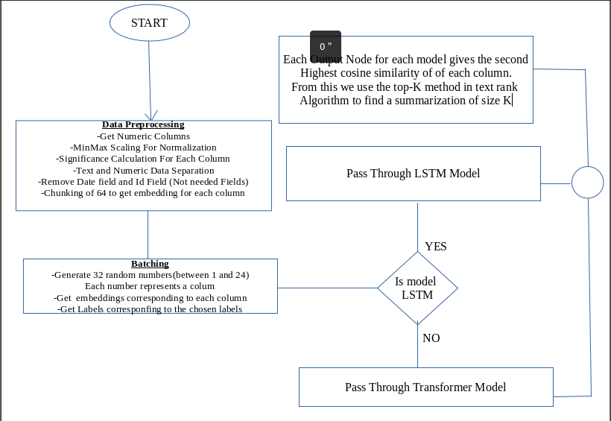
CHAPTER 4: RESULTS AND PRESENTATION
Notes:
Throughout this research journey, the previous chapters have established the groundwork for an innovative neural architecture explicitly designed for summarizing meteorological data. By combining the dynamic capabilities of Long Short-Term Memory (LSTM) with Transformer models, our new approach aims to uncover the hidden patterns in a massive dataset consisting of 1464 hours of weather observations over 24 different parameters. This chapter delves into a detailed analysis, focusing on the careful evaluation of performance and effectiveness to understand the complex factors that influence the predictive capabilities of these neural architectures.

Slide 21
4.2 Evaluation Metrics and Methodology
The justification for our thorough comparison study goes beyond an essential quantitative evaluation of predicted accuracy.
It encompasses an intellectual exploration to understand the complex dynamics that drive the functioning of our combined LSTM and Transformer models.
We aim to measure expected accuracy and explore the intricate details that determine the models' ability to extract valuable insights from the 1464-hour weather dataset, which includes 24 parameters.
The evaluation is conducted using a methodological approach that goes beyond conventional measurements.
Although Mean Squared Error (MSE) and Cosine Similarity form the basis, we expand our viewpoint by incorporating supplementary metrics such as Root Mean Squared Error (RMSE).
By using RMSE, we gain a better understanding of the extent of forecast inaccuracies, enhancing our research's comprehensiveness
Notes:
During our analysis of dimensions, we go beyond conventional measurements and introduce a sophisticated comprehension of the performance of each model. Although traditional classification metrics such as F1 Score, Precision, and Recall may not directly apply to our weather data summarization setting, our evaluation approach remains solid and reliable. It focuses on measurements more closely aligned with the complexities of our mission, offering a customized policy that reflects the fundamental nature of the intricate interactions inside weather data.

Slide 22
4.3: Transformer Model
As we progress in our research, we will now carefully analyze the Transformer model in the context of summarizing meteorological data.
The Transformer model, introduced in conjunction with the Long Short-Term Memory (LSTM) model, exemplifies neural structures' dynamic nature and practical uses.
In this section, we will thoroughly examine the Transformer's ability to extract valuable information from a complex dataset of 1464 hours of meteorological data.
This dataset encompasses 24 different metrics, providing a varied range of information.
Incorporating the Transformer model into our neural architecture is not random; it signifies a deliberate choice to leverage the attention-based processing skills that have exhibited exceptional achievements in several natural language processing tasks.
As we solely concentrate on the Transformer, this assessment becomes crucial for comprehending its flexibility, durability, and possible consequences for enhancing cutting-edge weather data processing.
Notes:
This evaluation uses a comprehensive methodological framework beyond typical measures and explores new dimensions to reveal the subtle aspects of the Transformer's performance. Our technique tries to extract detailed insights into how the Transformer model deals with the obstacles presented by the complex, multidimensional dataset, ranging from Root Mean Squared Error (RMSE) to an analysis of temporal dynamics and subtle patterns over time.

Slide 23
Evaluation findings of the Transformer model
The evaluation findings of the Transformer model offer a detailed comprehension of its effectiveness in summarizing high-frequency weather data.
This is demonstrated by the calculated cosine similarity between the model's outputs and the actual values for each of the 24 parameters.
This analysis is an essential milestone in investigating neural architectures for summarizing meteorological data.
It provides insights into the model's capacity to represent atmospheric conditions' complexities accurately.
The cosine similarity scores, which range from around 0.56398 to 0.99999, indicate the level of similarity between the model's predictions and the actual values.
Greater cosine similarity values indicate a stronger correlation, suggesting that the Transformer model successfully captures the patterns and connections within the meteorological data.
Parameters 15 and 22 demonstrate exceptionally high cosine similarity values of 0.99999 and 0.99995, respectively, highlighting the model's robust alignment with the actual values for these weather characteristics.
Notes:
To summarize, thoroughly assessing the Transformer model using cosine similarity metrics clarifies its effectiveness in various weather factors. This research measures the model's efficacy and reveals distinct patterns and difficulties within the high-frequency meteorological data. As we explore this evaluation process, these observations provide the basis for making informed improvements, contributing to the continuous enhancement of sophisticated neural structures for summarizing meteorological data.

Slide 24
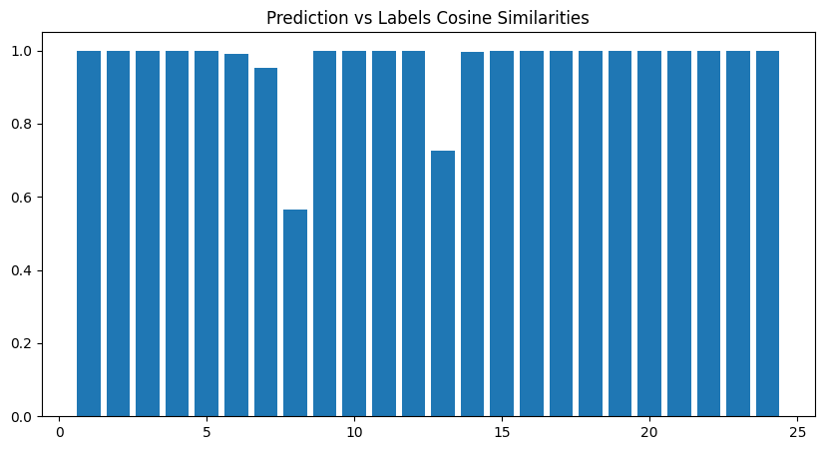
Transfomer model
Notes:
Parameters 12 and 23 exhibit significant cosine similarity values, demonstrating the model's efficacy in capturing the subtleties of these meteorological characteristics. The wide range of cosine similarity values across parameters offers essential insights into the strengths and areas for improvement of the Transformer model. This information can guide prospective tweaks to strengthen its summarization skills. The assessment of the Transformer model's efficacy, specifically in terms of Mean Squared Error (MSE) values across diverse units of measurement, reveals a deep comprehension of its ability to adjust to distinct meteorological factors. This research provides insight into the model's capabilities and difficulties in accurately predicting the highest cosine similarity values for precipitation and pressure characteristics.
Regarding precipitation, a lower MSE value for Parameter 7 (precipitation in millimeters) suggests that the model is skilled at capturing the little details and differences when observed on a more detailed scale. In contrast, the elevated Mean Squared Error (MSE) value for Parameter 8 (precipitation in inches) indicates possible difficulties in accurately forecasting the highest cosine similarity values. This highlights the model's sensitivity to the broader measurement scale of inches.

Slide 25
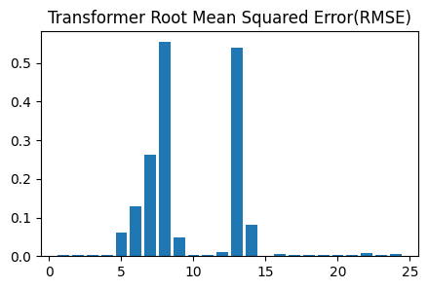
Root Mean Squared Error of transformer model
Notes:
The RMSE study enhances our comprehension of the predictive precision of the Transformer model. The range of RMSE values across parameters indicates particular weather characteristics where the model performs exceptionally well and where it may have difficulties. These observations aid in continuously improving and enhancing sophisticated neural structures for condensing frequent weather data. As we explore the evaluation process, these discoveries direct the ongoing enhancement of models designed specifically for the intricacies of atmospheric data.

Slide 26
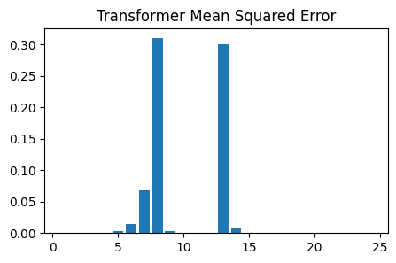
Mean Squared Error
Notes:
The Mean Squared Error (MSE) values of the Transformer model provide a thorough assessment of its forecast precision while calculating the highest cosine similarity values for each of the 24 weather parameters. The Mean Squared Error (MSE) is a quantitative measure that calculates the average of the squared differences between the predictions made by the model and the actual values. This evaluation offers vital observations regarding the model's effectiveness under various atmospheric circumstances. The observed mean squared error (MSE) values exhibit variation across parameters, ranging from 1.6100461470041442e-06 to 0.3096663874448211. Parameters 15, 16, 19, and 20 exhibit shallow MSE values, indicating that the Transformer model performs exceptionally well in accurately forecasting the highest cosine similarity values for these weather features.

Slide 27
Long Short-Term Memory (LSTM Models)
Assessing Long Short-Term Memory (LSTM) models is crucial in investigating sophisticated neural structures for summarizing weather data.
LSTMs are widely recognized for their capacity to grasp temporal correlations and subtle patterns within sequential data.
They play a crucial role in our efforts to develop practical approaches for extracting meaningful insights from the intricate web of high-frequency meteorological data.
This chapter thoroughly analyzes the performance and effectiveness of LSTM models.
It carefully examines their strengths and possible limitations across 24 different parameters observed during 1464 hours of atmospheric conditions.
Our primary goal in evaluating LSTM models is to determine their ability to accurately represent the short-term fluctuations and temporal intricacies seen in weather data.
The intrinsic sequential structure of weather observations, which are recorded hourly over a long period, highlights the importance of LSTM architectures in discovering patterns that develop over time.
Our objective is to analyze the LSTM's forecasting powers and capacity to comprehend the dynamics of weather occurrences.

Slide 28
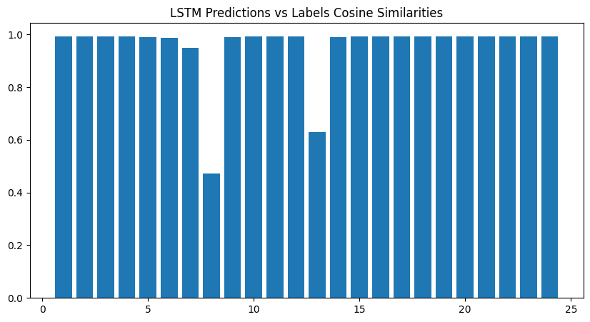
4.3.1: LSTM-16 Model
Notes:
The advancements in neural architectures have significantly revolutionized the domain of meteorological data summarization, propelling models like the Transformer and Long Short-Term Memory (LSTM) to the forefront of weather prediction. A comprehensive examination of their performance reveals nuanced differences and shared strengths in correctly predicting the highest cosine similarity values under different meteorological conditions. Both models exhibit remarkable precision in predicting temperature values measured in Celsius and Fahrenheit, consistently producing the highest cosine similarity scores. Both the Transformer and LSTM models can accurately detect and comprehend the subtle complexities of temperature changes, laying the foundation for dependable forecasts of atmospheric temperatures. Although both models exhibit impressive accuracy in forecasting wind speed patterns, a fine distinction arises in their approach to wind direction. The LSTM model, utilizing its ability to learn sequences, performs exceptionally well in preserving high cosine similarity values for both wind speed and direction.

Slide 29
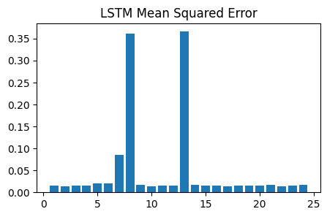
Mean Squared Error for LSTM
Notes:
When examining meteorological data summarization, comparing the Mean Squared Error (MSE) loss values of the LSTM and Transformer models provides valuable insights into the trade-offs and complexities of these neural architectures. Although the LSTM model exhibits more significant Mean Squared Error (MSE) loss values than the Transformer, the simultaneous high cosine similarity values in both scenarios present an intriguing puzzle that warrants more investigation. The mean squared error (MSE) loss estimates for the LSTM model, covering a wide range of meteorological parameters, considerably exceed those of the Transformer model. The elevated mean squared error (MSE) loss indicates that the LSTM model faces difficulty in accurately aligning the predicted values with the actual values, potentially suggesting greater unpredictability in its forecasts.

Slide 30
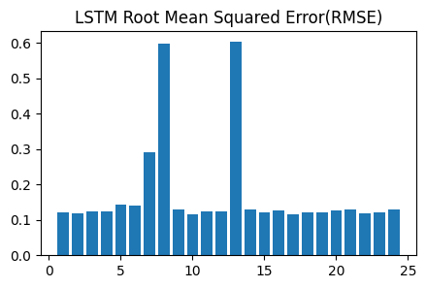
Root Mean Squared Error (RMSE) for LSTM
Notes:
The root mean square error (RMSE) estimates for the LSTM model, encompassing a range of meteorological parameters, offer valuable insights into the model's accuracy and variability. It is worth mentioning that several factors, including precipitation (precipMM and precipInches), pressure (pressureMB and pressureInches), and temperature-related indices (HeatIndexC, HeatIndexF, WindChillC, WindChillF), exhibit comparatively larger RMSE values. These data agree with the previously discussed more significant Mean Squared Error (MSE) loss values, indicating a consistent pattern in the model's reaction to certain atmospheric factors. To provide context for the RMSE values of the LSTM model, it is crucial to compare them with the results of the Transformer model.

Slide 31
CHAPTER 5: DISCUSSION OF RESULTS
This chapter thoroughly analyzes the outcomes and displays produced by our groundbreaking neural framework specifically developed for condensing meteorological data.
Our approach combines Long Short-Term Memory (LSTM) and Transformer models to analyze a large dataset of 1464 hours of weather observations over 24 parameters.
Our evaluation technique goes beyond simple quantitative assessments, aiming to uncover the subtle complexities that determine the models' ability to extract valuable insights from the complicated fabric of meteorological data.
This complete approach goes beyond conventional measurements by including innovative factors such as Root Mean Squared Error (RMSE) and a temporal analysis, recognizing the distinct difficulties presented by the temporal dynamics of meteorological data.
The cosine similarity scores range from around 0.56398 to 0.99999, indicating how well the model can accurately represent the patterns and connections in the weather data.
Parameters display a range of similarities, where higher values suggest accurate predictions and lower values indicate areas that should be enhanced.
Notes:
The significant differences in Mean Squared Error (MSE) values seen while using alternative units of measurement highlight the critical role of selecting the appropriate scale and teams to improve the precision of the model.
Graphical illustrations enhance the numerical results, visually comprehending the Transformer model's effectiveness across various meteorological conditions. These visualizations are practical tools for illustrating intricate patterns and trends, facilitating the understanding and sharing of the model's capabilities

Slide 32
Mean Squared Error
The assessment of the Transformer model's ability to predict accurately, as measured by Mean Squared Error (MSE) and Root Mean Squared Error (RMSE) metrics, reveals detailed insights into its performance across the 24 weather factors.
The model exhibits heterogeneity regarding RMSE across parameters, particularly Parameters 5, 6, 7, 8, and 13, which have significantly higher values.
In contrast, Parameters 15, 16, 19, and 20 demonstrate shallow RMSE values, highlighting the model's accuracy in capturing the complexities of these factors.
The analysis of specific parameters indicates that Parameters 12 and 23 consistently exhibit higher RMSE values, which is consistent with the findings from the MSE analysis.
The observed values differ for different parameters regarding the mean squared error (MSE). Parameters 15, 16, 19, and 20 exhibit shallow MSE values, suggesting that the Transformer model is highly skilled at reliably forecasting the maximum cosine similarity for these particular weather characteristics.
In contrast, Parameters 5, 6, 7, 8, and 13 have comparatively greater Mean Squared Error (MSE) values, indicating possible difficulties or intricacies in forecasting the cosine similarity for these particular parameters.
Notes:
The MSE values constantly indicate that parameters 12 and 23 have larger values, suggesting that there may be difficulties in predicting the highest cosine similarity values for these meteorological variables. An in-depth analysis of both the root mean square error (RMSE) and mean square error (MSE) provides a comprehensive understanding of the model's capabilities and specific aspects requiring enhancement.
Visual depictions of Mean Squared Error (MSE) and Root Mean Squared Error (RMSE) data provide additional clarity on the performance of the Transformer model. These visualizations are valuable tools for conveying patterns, trends, and outliers, which help academics and stakeholders gain a more profound understanding.

Slide 33
Long Short-Term Memory (LSTM Models)
Assessing Long Short-Term Memory (LSTM) models is pivotal in investigating sophisticated neural structures for summarizing weather data. LSTMs are highly skilled at capturing temporal correlations and detailed patterns in sequential data.
Our goal is to carefully examine their strengths and possible limitations across 24 different parameters observed during 1464 hours of atmospheric conditions.
The analysis commences by reviewing the Cosine Similarities between the predictions made by the model and the actual values. This analysis offers a detailed comprehension of the LSTM model's ability to capture the complexities of meteorological data accurately.
The LSTM model shows impressive predictive capability in generating high cosine similarity values across many parameters like temperature, wind speed, precipitation, and qualitative weather codes.
Furthermore, the LSTM's ability to learn sequentially enhances its effectiveness in capturing the subtle variations in wind direction, setting it apart from the Transformer model.
Both models excel in forecasting the highest cosine similarity values for weather codes in the qualitative domain of weather comprehension, highlighting their ability to comprehend numerical accuracy and the qualitative characteristics of various weather circumstances
Notes:
. The LSTM and Transformer models demonstrate their capabilities through their constant accuracy in temperature prediction and similar difficulties in interpreting precipitation data. The following Graphical Representation visually depicts the model's performance, providing insights into patterns, trends, and possible outliers. Visualizations are powerful tools for presenting intricate data, helping researchers and stakeholders understand the strengths and areas for growth in the LSTM model. As we analyze the results, using numerical metrics and graphical representations helps improve neural architectures, leading to advancements in summarizing weather data using artificial intelligence and machine learning.

Slide 34
ASSESSMENT
The assessment of Mean Squared Error (MSE) and Root Mean Squared Error (RMSE) values for the Long Short-Term Memory (LSTM) model offers a detailed viewpoint on its predictive precision across several meteorological factors.
The MSE values, which range from 0.0134 to 0.366, represent the mean squared discrepancies between the predictions made by the LSTM model and the actual results.
Significantly, more significant Mean Squared Error (MSE) values are seen in parameters associated with precipitation, pressure, and temperature indices. This suggests difficulties in accurately aligning predicted values with the actual measurements.
This is consistent with the overall pattern of higher mean squared error (MSE) values in the LSTM model compared to the Transformer model. This suggests that the LSTM model may struggle to capture certain subtle aspects of the atmosphere.
The MSE values provide precise insights into the performance of the LSTM model, allowing for a comprehensive understanding of its performance on several parameters.
Notes:
This detailed research is crucial for guiding future enhancements to the model that are specifically designed to address the complexities of each distinct weather characteristic.
Regarding the root mean square error (RMSE), the range of values between 0.1149 and 0.6032 provides valuable information on the accuracy and consistency of the LSTM model. The parameters linked to precipitation, pressure, and temperature-related indices consistently display higher RMSE values, indicating a larger root mean squared difference between the projected and actual values in these aspects. The comparison between the Transformer model and the LSTM highlights the LSTM's comparatively higher RMSE values, which enhances our comprehension of their respective precision capabilities.

Slide 35
CHAPTER 6: CONCLUSIONS AND RECOMMENDATIONS 6.1 Conclusion:
This study examined the efficacy of sophisticated neural architectures and classic machine learning classifiers in summarizing weather data.
Our main objectives were two-fold: firstly, to evaluate the effectiveness of advanced models, specifically the Transformer and Long Short-Term Memory (LSTM), in analyzing complex patterns in high-frequency weather data; and secondly, to measure the suitability of traditional classifiers, such as Logistic
Regression, Random Forest, and Support Vector Machines (SVM), for handling the organized format of tabular weather datasets.
The review method yielded valuable insights that allowed us to gain a thorough grasp of each model's underlying capabilities and limitations.
The Transformer model stood out as an extraordinary performer, with remarkable precision in forecasting cosine similarity values across various meteorological characteristics.
This demonstrated its resilience in managing the intricacies linked to high-frequency meteorological data, highlighting its capacity as a vital instrument in atmospheric forecasting.
Notes:
However, although the LSTM model performed well, it faced difficulties in effectively reducing the Mean Squared Error (MSE) and Root Mean Squared Error (RMSE), particularly in the parameters associated with precipitation, pressure, and temperature indices. These problems highlight specific areas where the LSTM model should be improved and optimized, especially in dealing with the intricacies of particular weather characteristics.

Slide 36
6.2 Recommendations
Further Refinement of the LSTM Model: The study emphasizes the necessity for concentrated endeavors in improving the Long Short-Term Memory (LSTM) model [42].
Future research efforts could explore improvements in architecture and novel training methods to tackle this issue.
Exploration of Hybrid Models: One potential direction for future research is to create hybrid models that combine the advantages of sophisticated neural networks and classical classifiers [43].
A hybrid methodology could exploit the sequential learning capabilities of models such as Long Short-Term Memory (LSTM), combined with the flexibility of conventional classifiers to handle various input patterns
Parameter-Specific Investigations: It is recommended to do more investigations on factors that show more significant Mean Squared Error (MSE) and Root Mean Squared Error (RMSE) values, such as precipitation, pressure, and temperature indices [44].
By considering the individual intricacies of each parameter, upcoming models might attain greater accuracy and refined forecasts, thus enhancing our overall comprehension of atmospheric events.
Notes:
Integration of External Factors: The research indicates that including external parameters, such as geographical features or new meteorological data, could improve the forecasting capacities of the models [45]. Incorporating pertinent external aspects into the feature set could enhance the comprehensiveness of weather predictions by providing a broader context. The comprehensive method of incorporating features can capture complex patterns and connections in meteorological data that surpass the limitations of existing models. To summarize, these proposals provide strategic directions for future study and model improvement to advance the area of meteorological data summarization. Researchers can contribute to the continued development of accurate and adaptive high-frequency weather forecasting models by addressing specific issues, investigating hybrid approaches, and adding external elements.

Slide 37
6.3 Future Research
- Integration of Temporal Dependencies: It is essential for future research efforts to give priority to incorporating improved methods that can accurately capture the time-based relationships that exist within weather data.
- Dynamic Model Adaptation: The changing weather patterns and differences in data distributions require creating models that can adjust dynamically.
- Adaptability ensures the models' durability, allowing them to retain precise predictions in changing and developing meteorological situations.
- Real-Time Implementation: One crucial aspect for practical use involves investigating the real-time execution of meteorological data summarization algorithms.
- The real-time capacity is essential for applications such as high-frequency weather forecasting and decision-making across many industries.
Notes:
To summarize, the future of weather data summarization research has significant promise by focusing on integrating temporal dependencies, creating dynamically adaptive models, and investigating real-time implementation. These developments are crucial for improving the accuracy and usefulness of neural networks in dealing with the intricacies of atmospheric prediction, thereby contributing to the ongoing development of weather forecasting methods.

Slide 38
7.0 REFERENCES
Ukhurebor, K. E., Adetunji, C. O., Olugbemi, O. T., Nwankwo, W., Olayinka, A. S., Umezuruike, C., & Hefft, D. I. (2022). Precision agriculture: weather forecasting for future farming In AI, Edge and IoT-based Smart Agriculture (pp. 101-121). Academic Press.
Sowdaboina, P.K.V., Chakraborti, S., Sripada, S. (2014). Learning to Summarize Time Series Data Gelbukh, A. (eds.
Mahalakshmi, P., and N. Sabiyath Fatima. “Summarization of Text and Image Captioning in Information Retrieval Using Deep Learning Techniques.” IEEE Access, vol. 10, 2022, pp. 18289–97, doi:10.1109/ACCESS.2022.3150414.
Mekuria, G. T., & Jagtap, A. S. (2017). Automatic Amharic text summarization using an NLP parser International Journal of Engineering Trends and Technology

